Slide 2
Agora ?
What the heck is

Slide 3
We are …
A ttractive
G orgeous
O pen-minded
R adiant
A ctive

Slide 4
More seriously we are..
a Past Circler Organisation founded by Past-Circlers 30 years ago
internationally active for over 20 years
acting according to our motto: „Service and Tolerance“
member of the Round Table Family
open for ex-circlers and non ex-circlers

Slide 5
we continue lifelong friendship we built up in Ladies Circle
we make new friends around the world
we maintain and improve our relationship with LC, RT, 41 and Tangent
we travel nationally and internationally
We do service on a voluntary basis
We have fun!

Slide 6
We are present in 20 countries!

Slide 7
Since 2016 we have our own
International Service Project
„Eyes for the World“
and we support the
LCI-ISPs

Slide 8
What about history?
1987 past-circlers create the first Agora Club in Lille, France
1993 first Agora Club in The Netherlands
1994 first Agora Club in Belgium
1996 Agora Club International is founded in Strasbourg
2009 The first Tangent Country (Germany) joins ACI

Slide 9
Agora means….. „my future“!
„Amazing follow-up of Ladies Circle“
„Lasting loving friendship with the most amazing women“
„Pleasure to share friendship around the world“
„Create a whole world of new possibilities“
„Meeting wonderful people that otherwise would never have crossed my path“
„Lots of laughter“

Slide 10
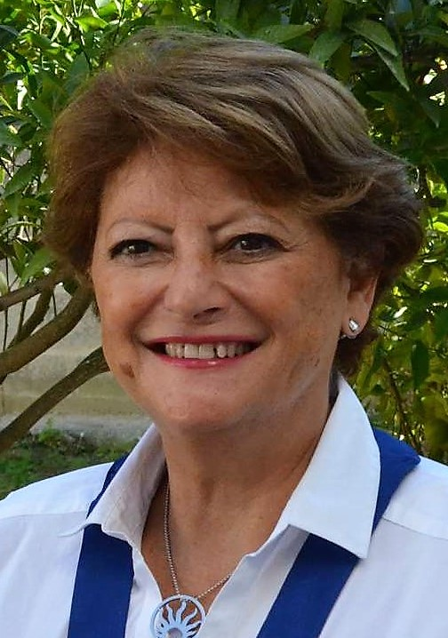
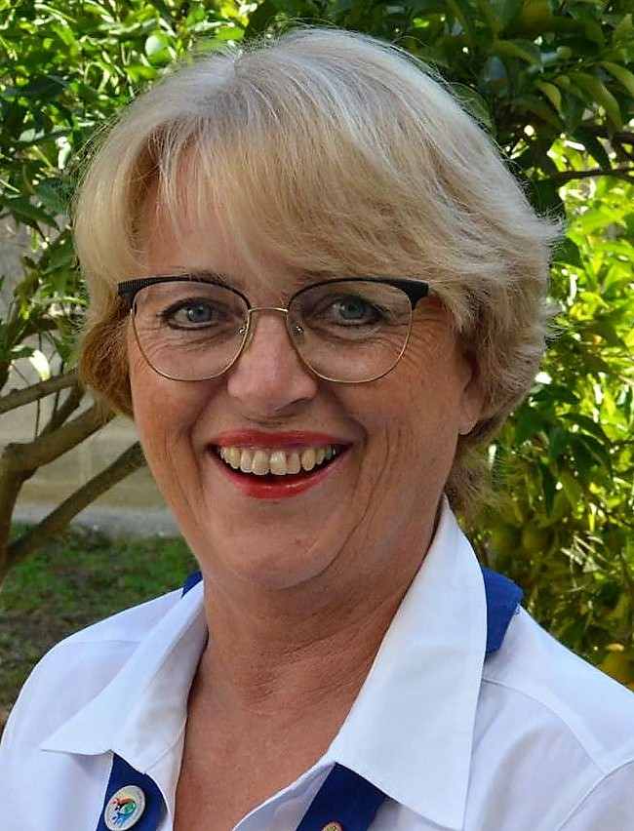
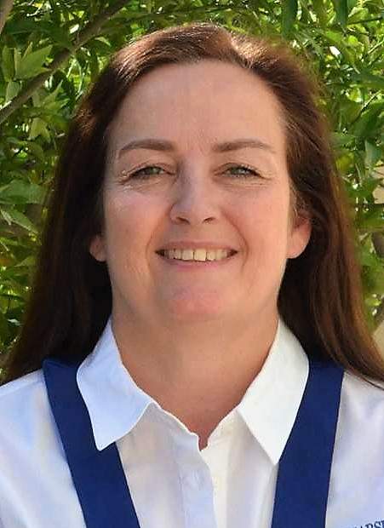
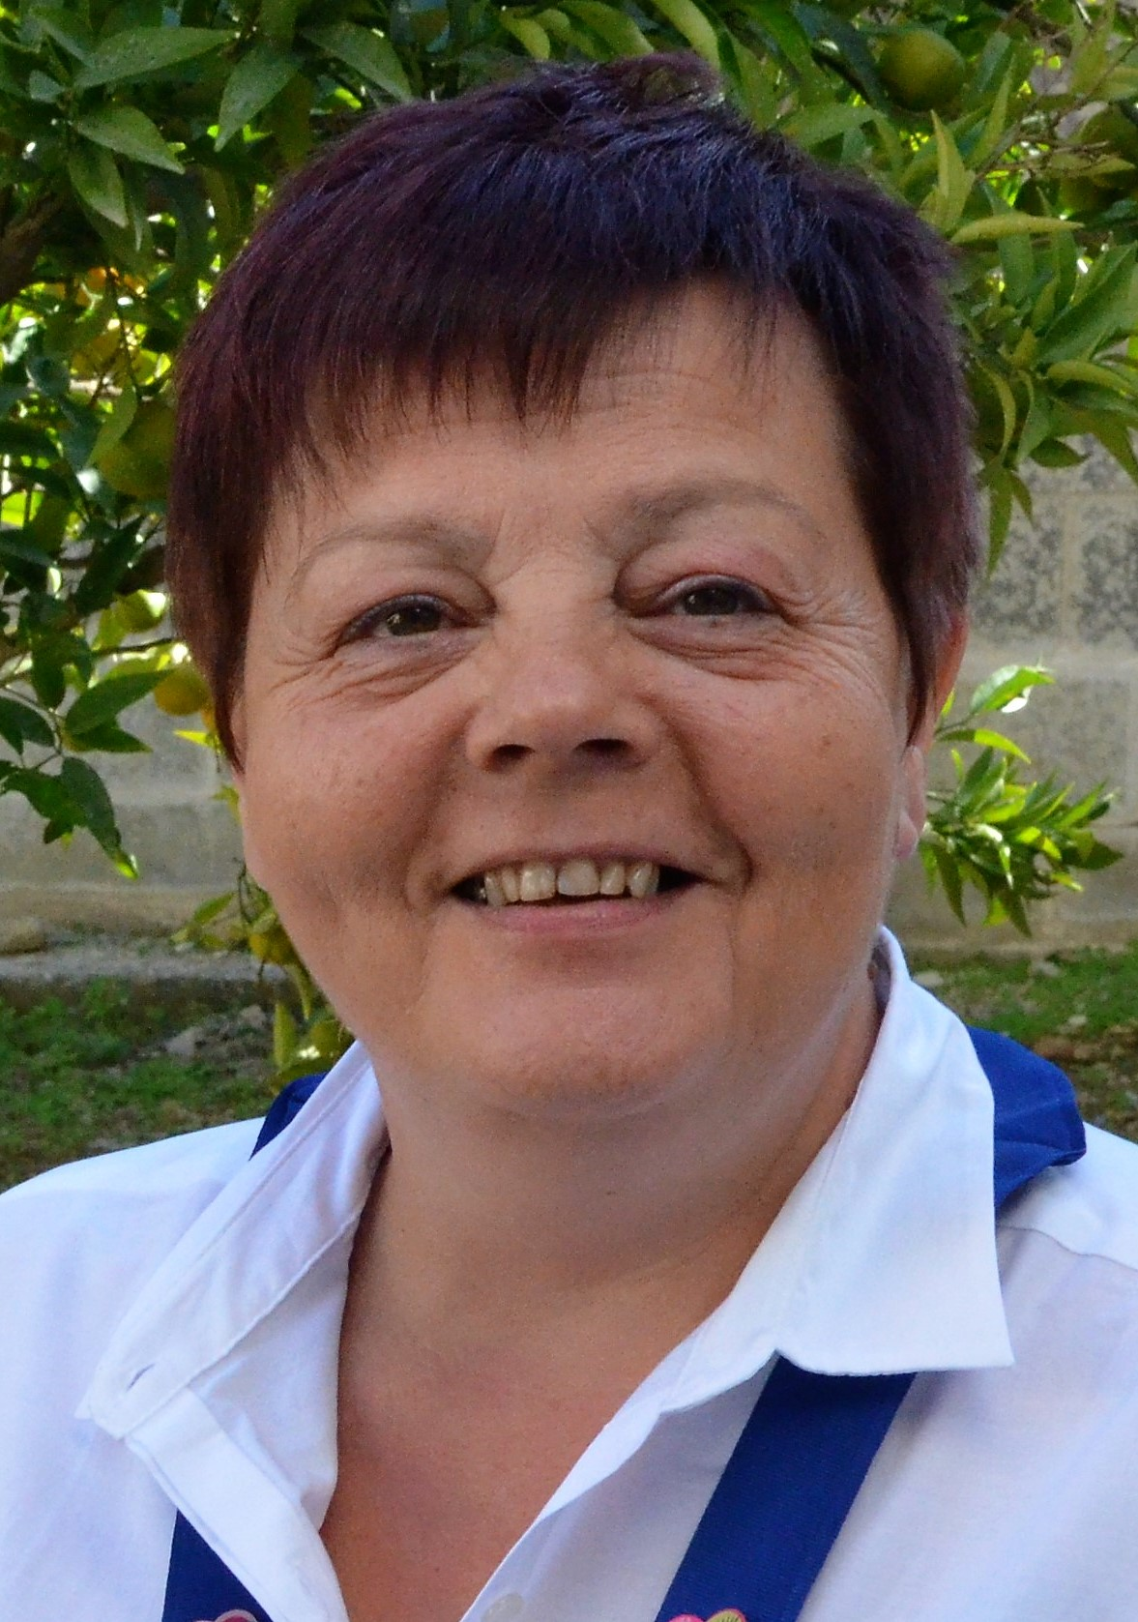
The International Board 2017-2018
Vice President
Anna Tabone
AC Malta
Immediate Past President
Ursula Lejeune
ACT Germany
President
Isabelle Seguinot
AC France
Secretary
María Erla Hilmarsdóttir
AC Iceland
Treasurer
Yvonne Houben
AC Belgium

Slide 12
www.agoraclubinternational.com
„Forever young – forever friends“

