Slide 1
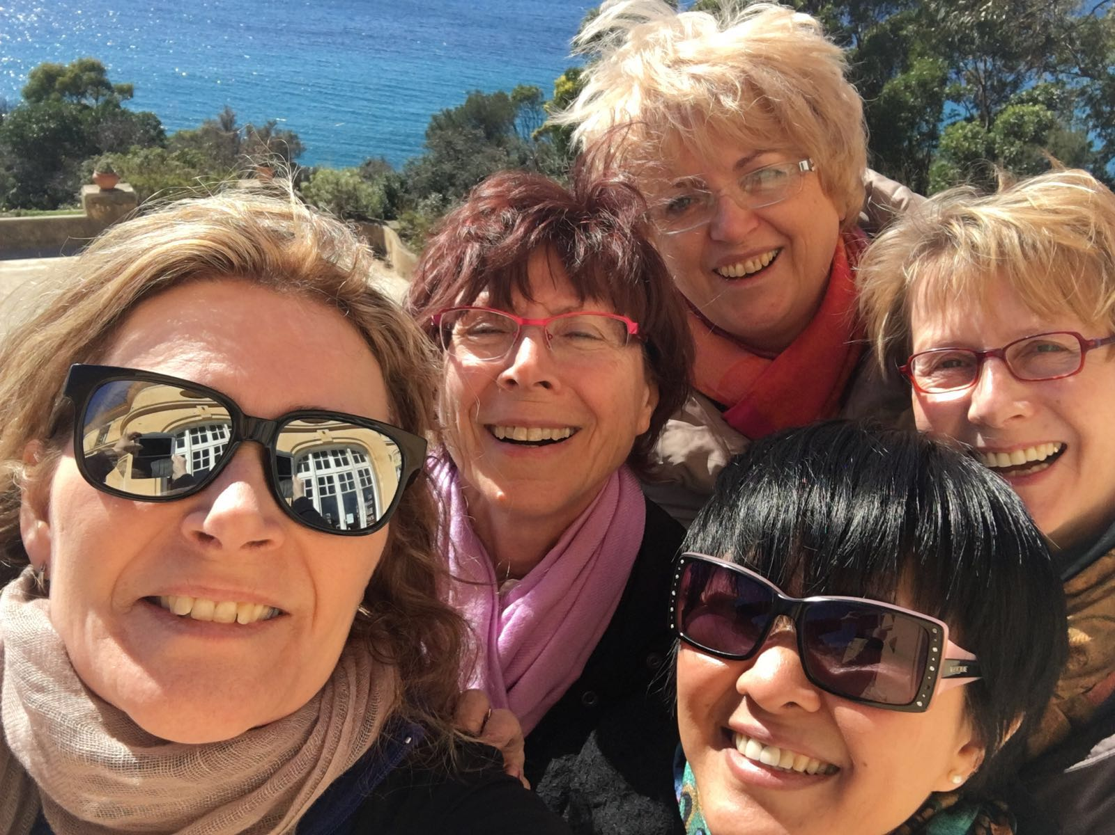


COMBINED YEAR END REPORT 2015-2016
BROUGHT TO YOU BY ~
KELLY, MARTINE, URSULA, THANH THAO & BRIGITTE

Slide 2
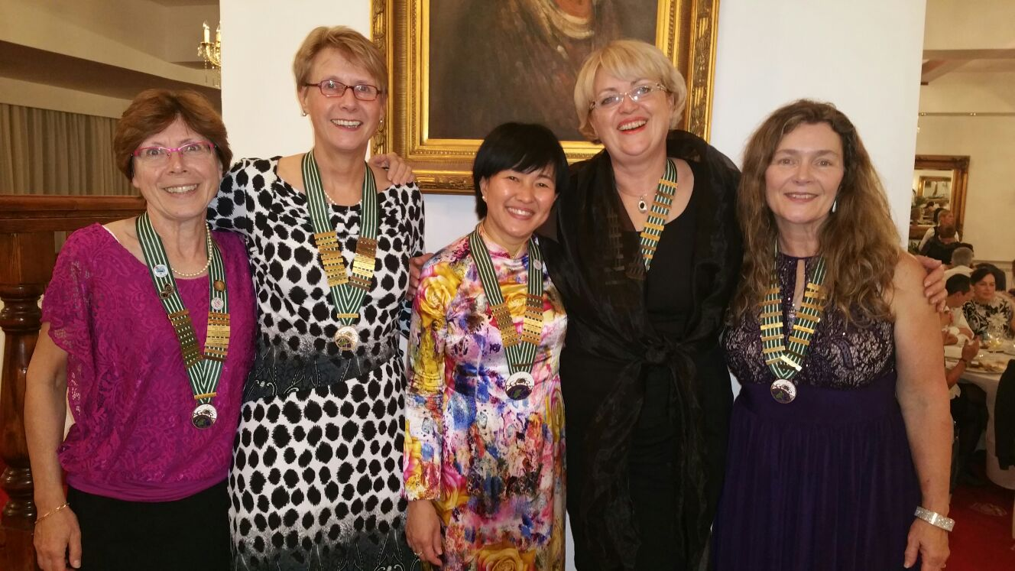

WE BEGAN OUR YEAR…
FIRST BOARD MEETING IN SACELE, ROMANIA!

Slide 3
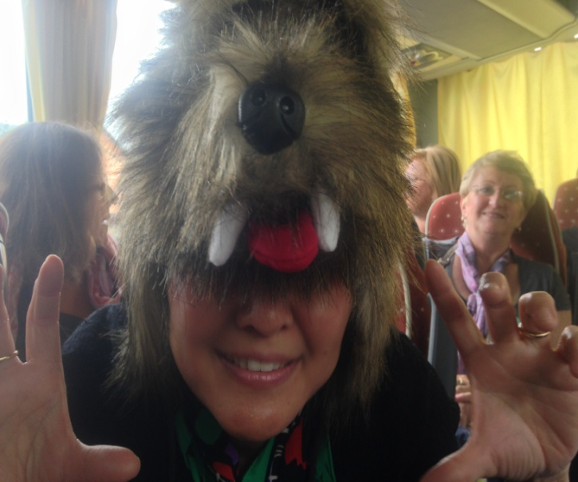
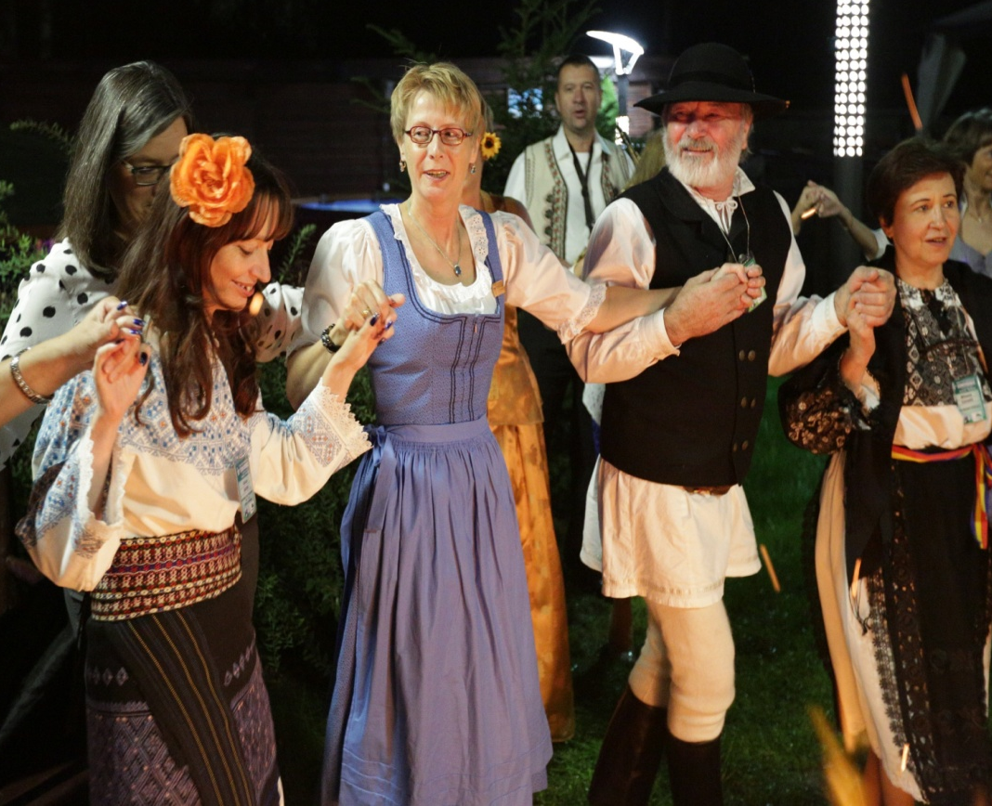
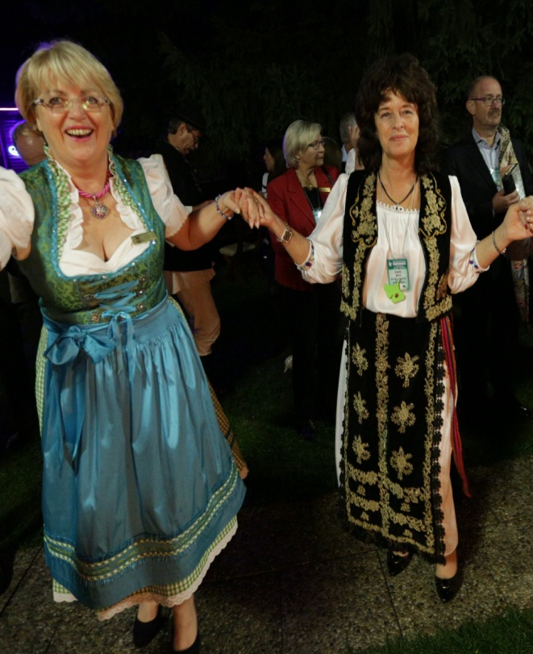
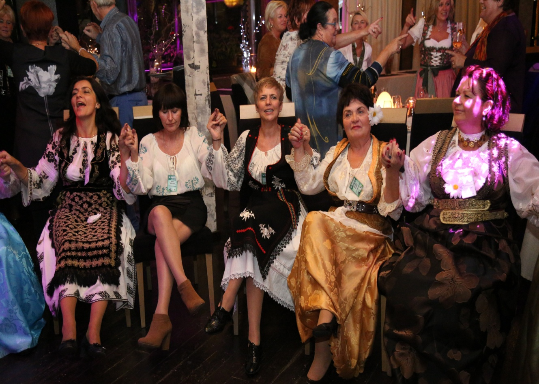
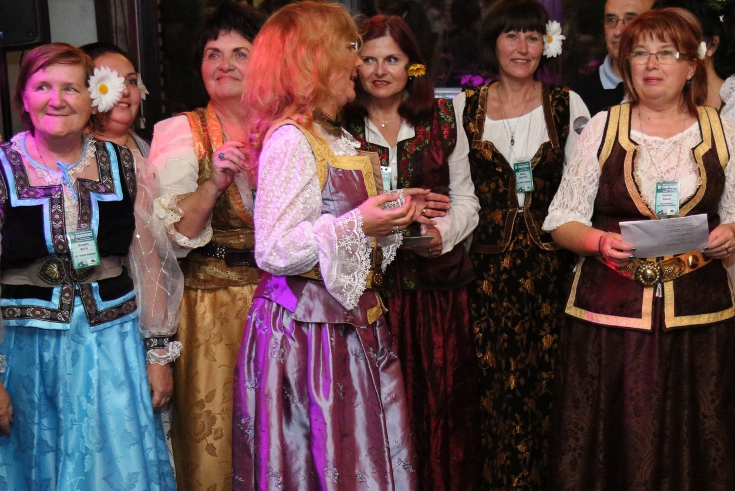
AGORA ROMANIA
WE LOVED OUR TIME WITH YOU!

Slide 4
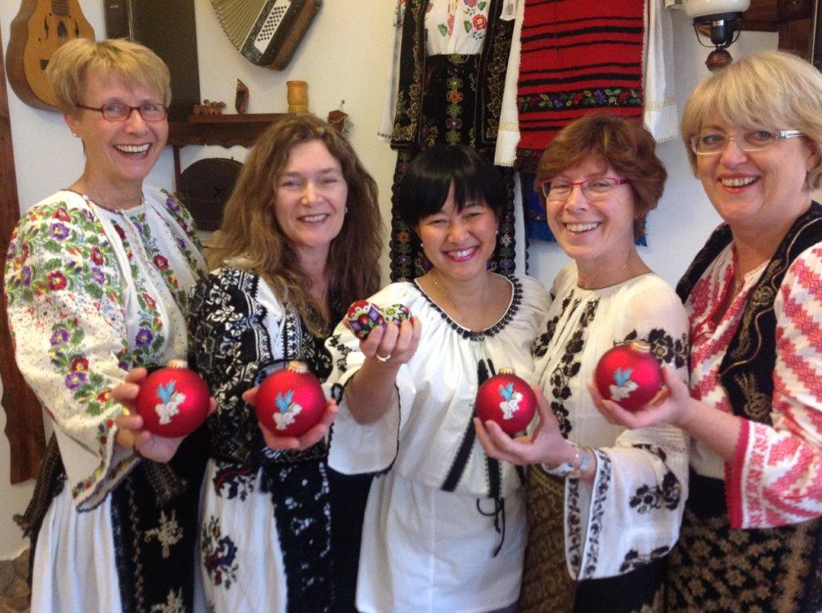
THANK YOU MIHAELA FOR HOSTING US!
YOUR SENSE OF HUMOUR STILL HAS US SMILING!
☺

Slide 5
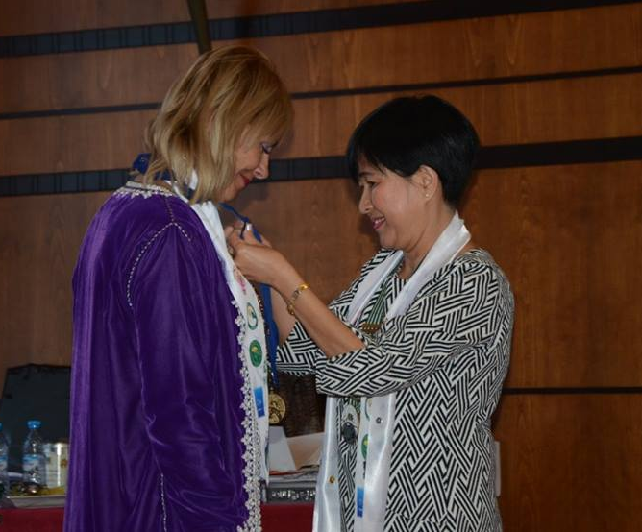
WE CARRIED OUT OUR FIRST OFFICIAL ACTION -
THE INSTALLATION OF THE NATIONAL BOARD OF
AGORA CLUB MOROCCO!

Slide 6
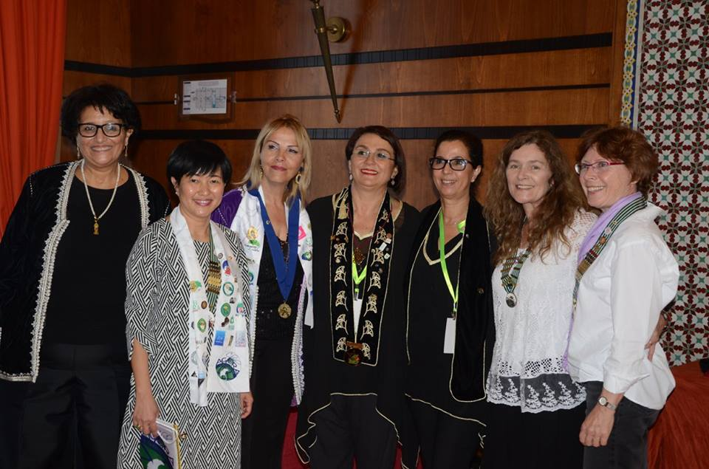

Slide 7
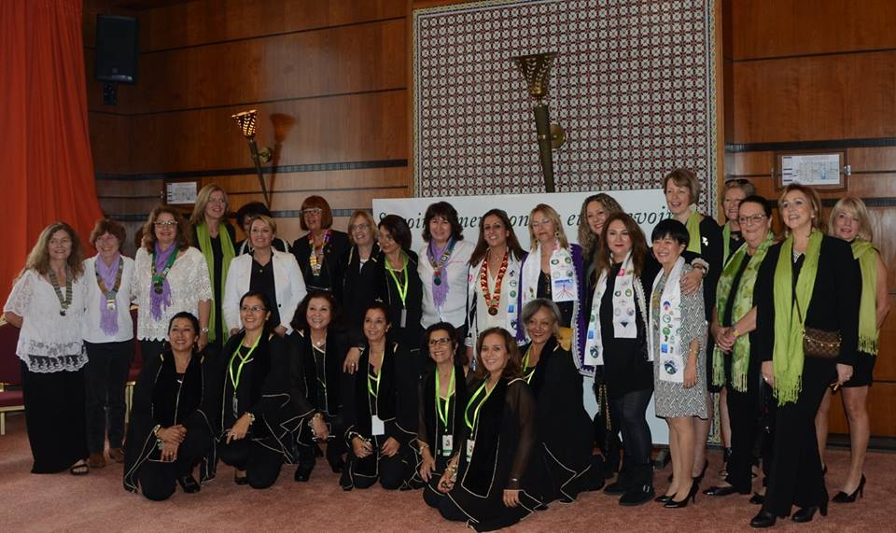

Slide 8
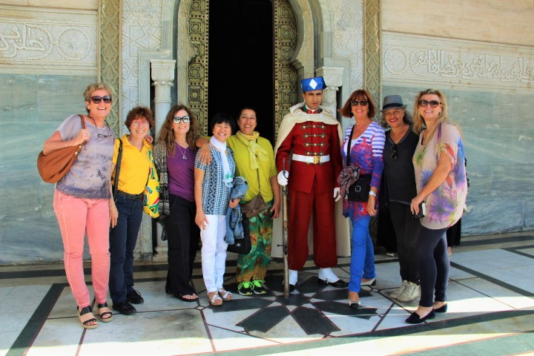
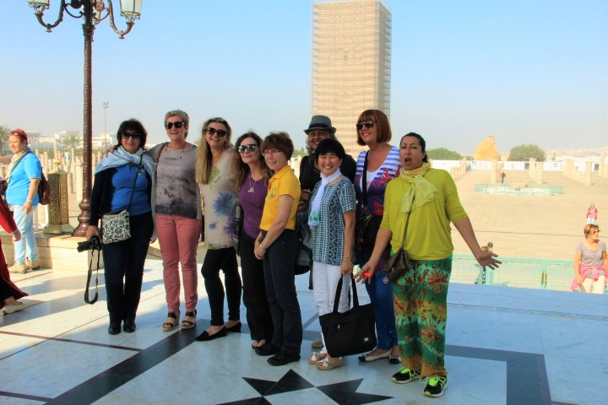
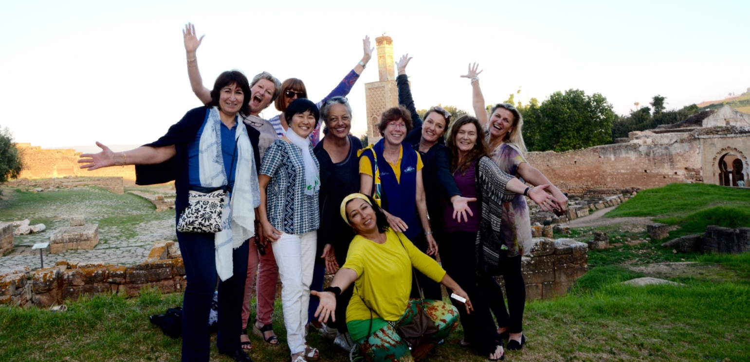
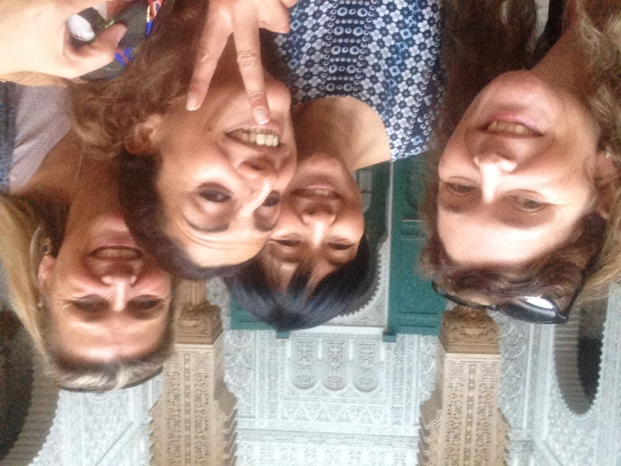
WITH SOME TIME FOR TOURING THE LOCAL SITES!
& SHARING IN THE LOCAL BEAUTY

Slide 9
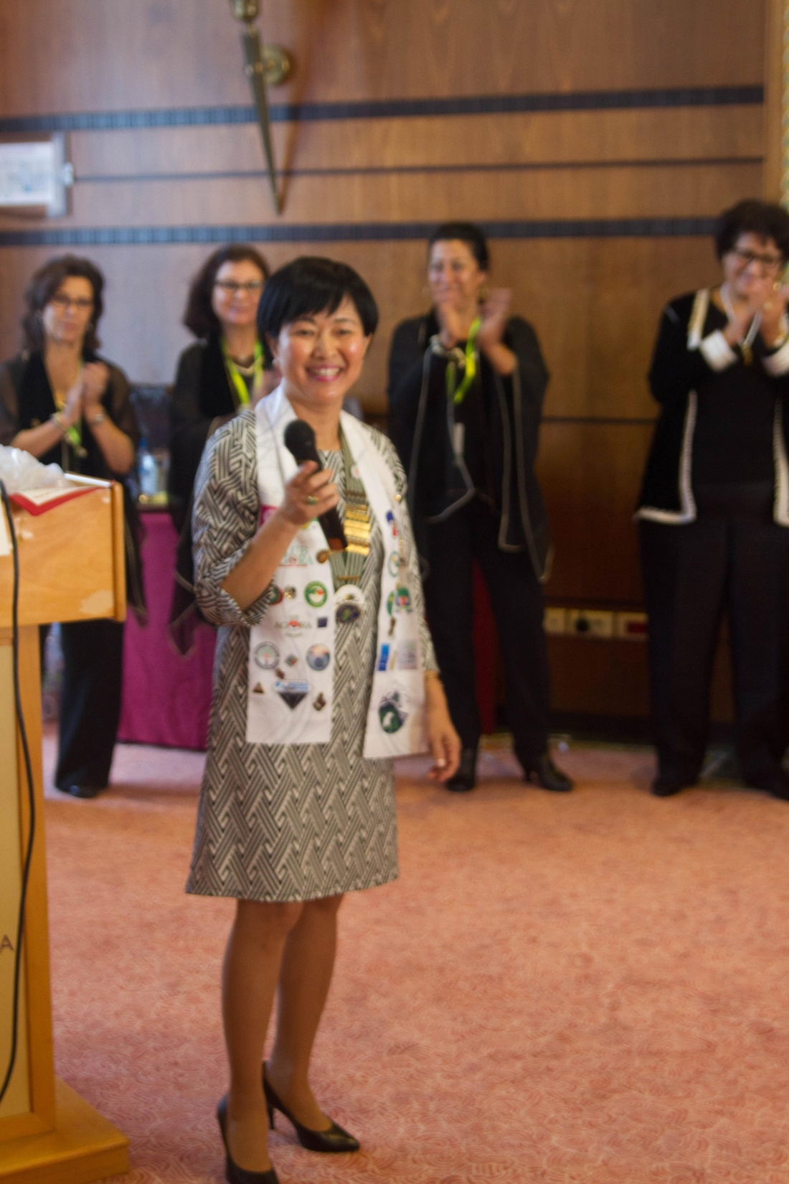
A LOVELY BEGINNING TO A MOST BEAUTIFUL YEAR!

Slide 10
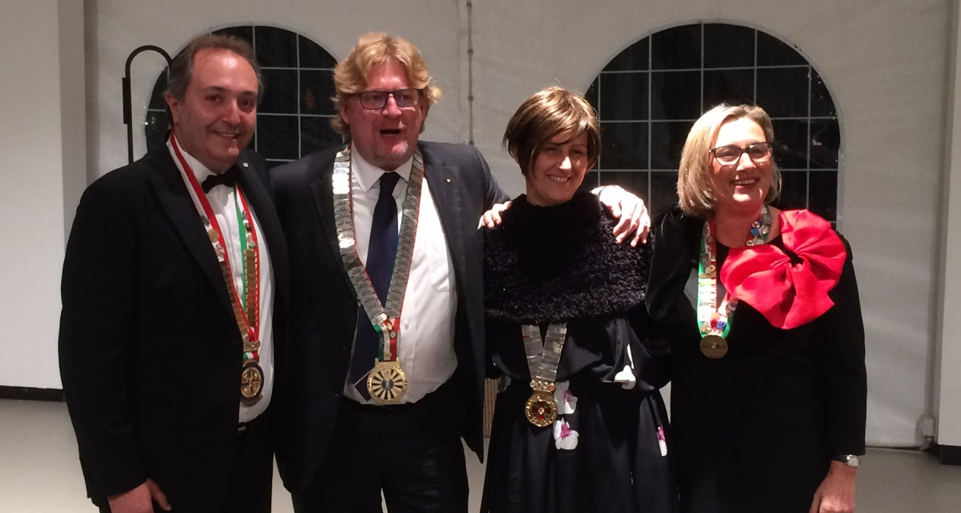
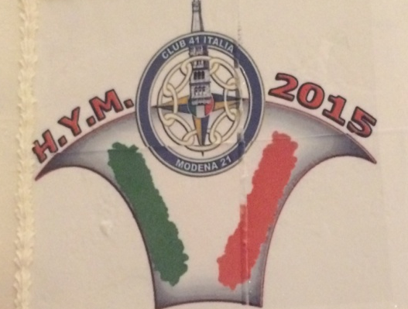
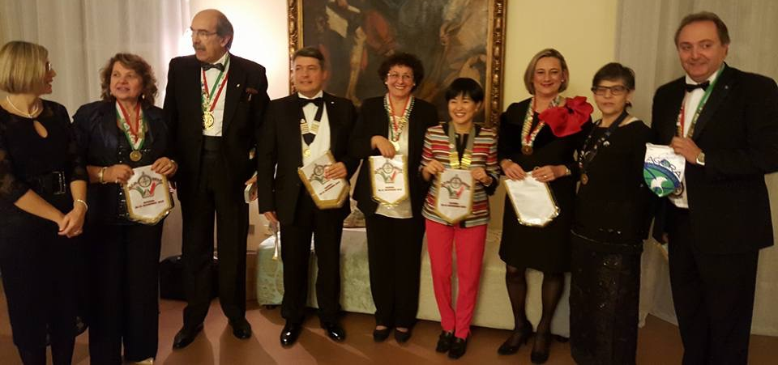
THANH THAO ATTENDS ITALY 41 HYM

Slide 11
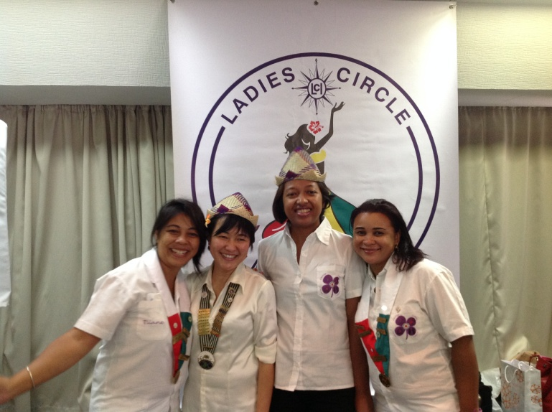
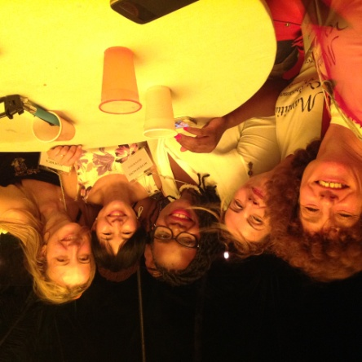
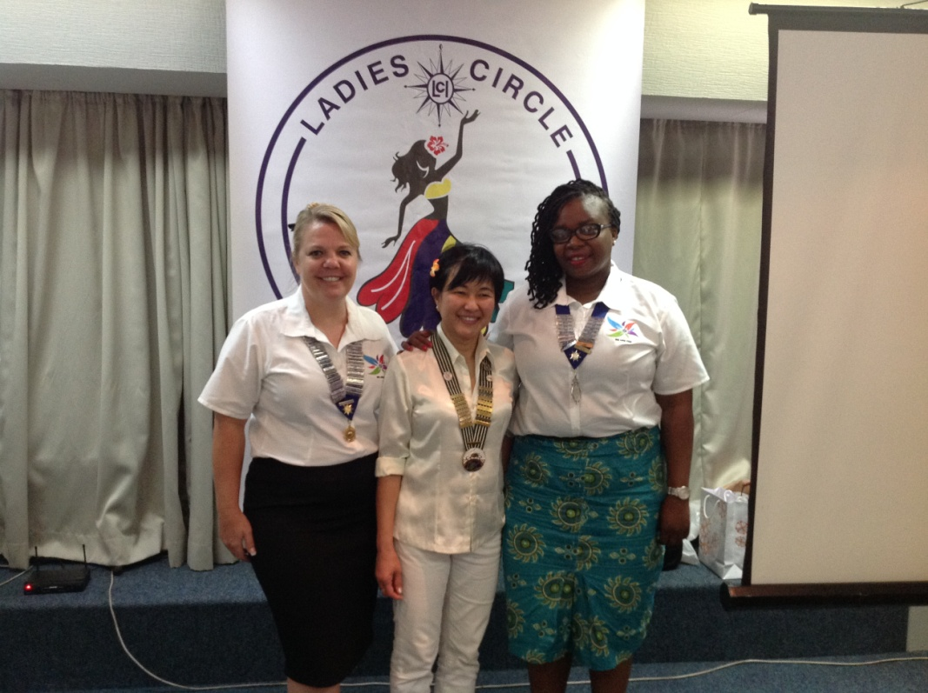
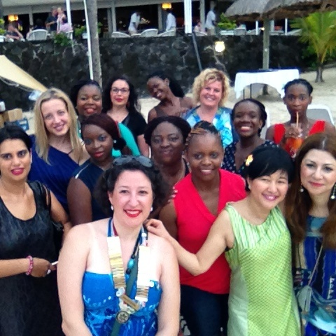
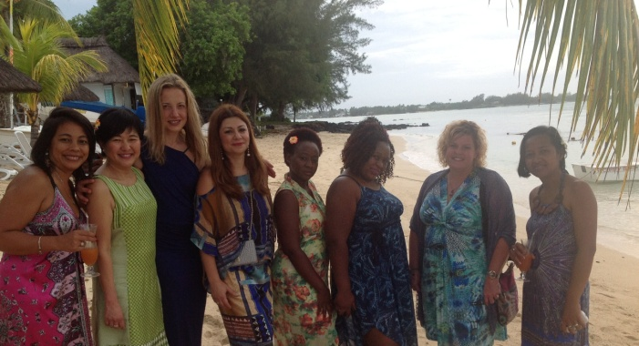
THANH THAO ON TO THE MTM OF LCI IN MAURITIUS!
SURROUNDED BY THE PAST THE PRESENT AND THE FUTURE OUR FRIENDSHIPS BRING…..

Slide 12
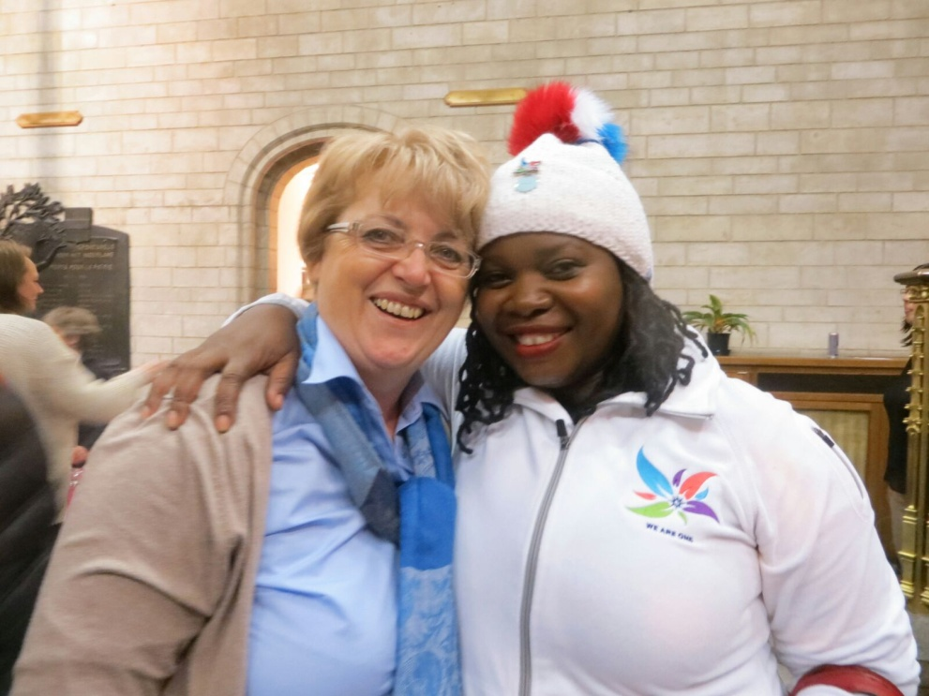
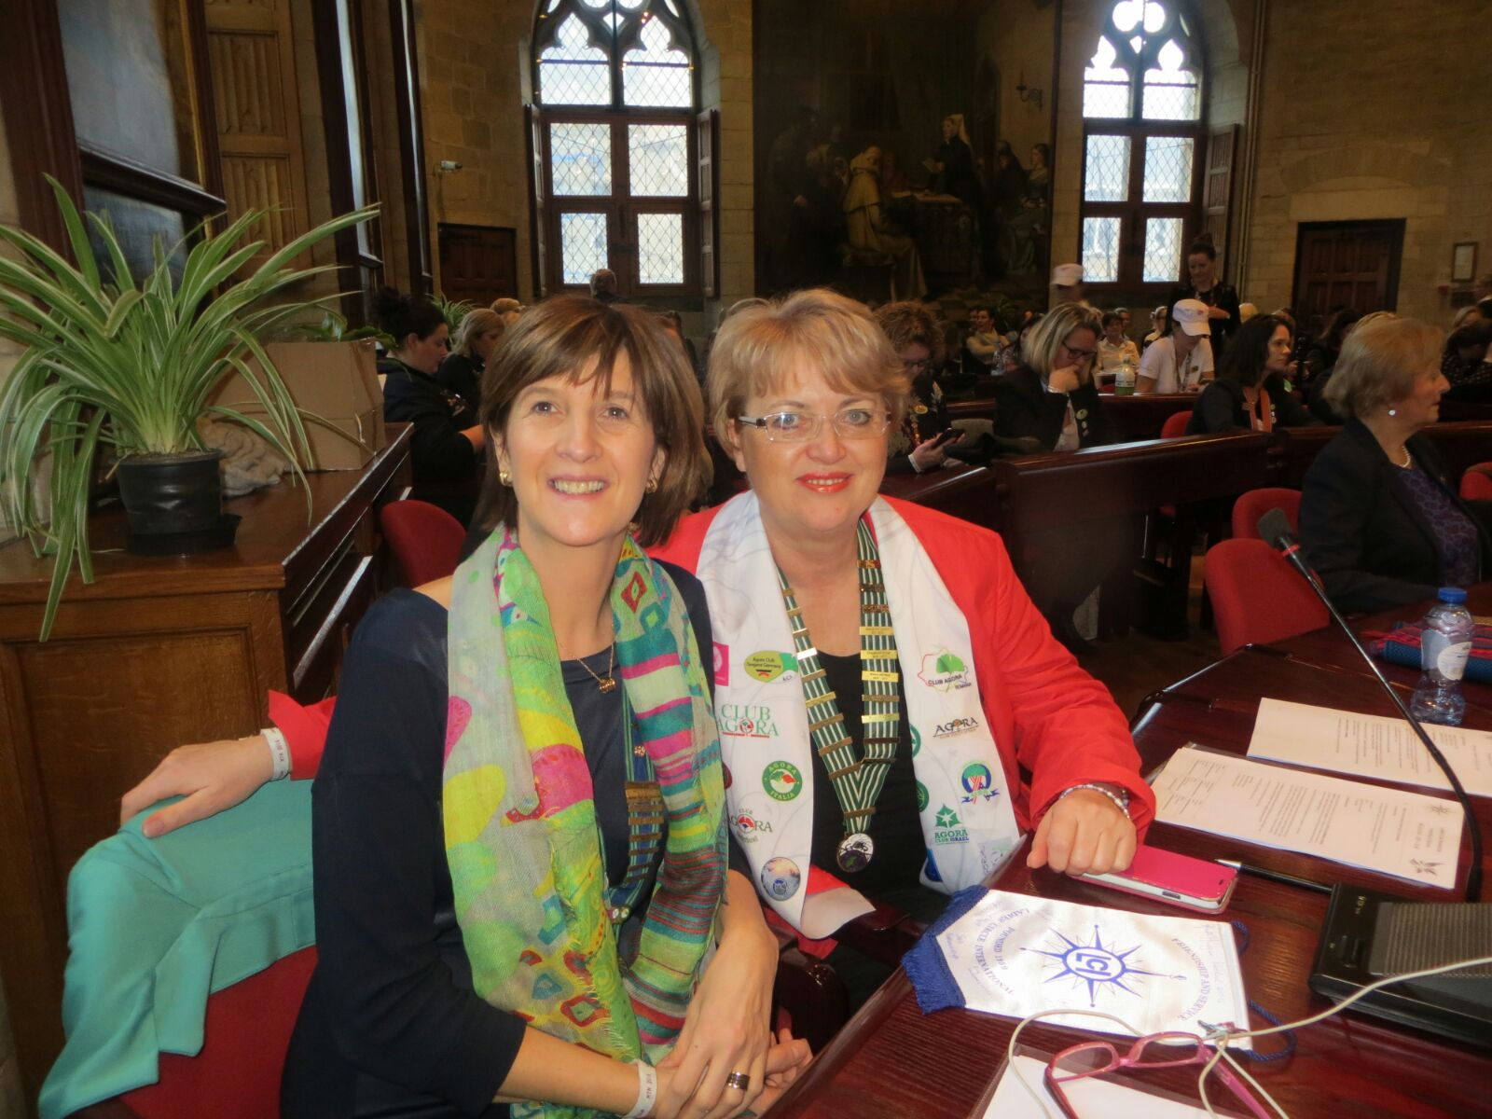
URSULA AT LCI MTM IN LEUVEN!
IN COLDER CLIMATES OUR WOOLLY HATS…..
AND OUR FRIENDSHIPS KEEP US WARM!

Slide 13
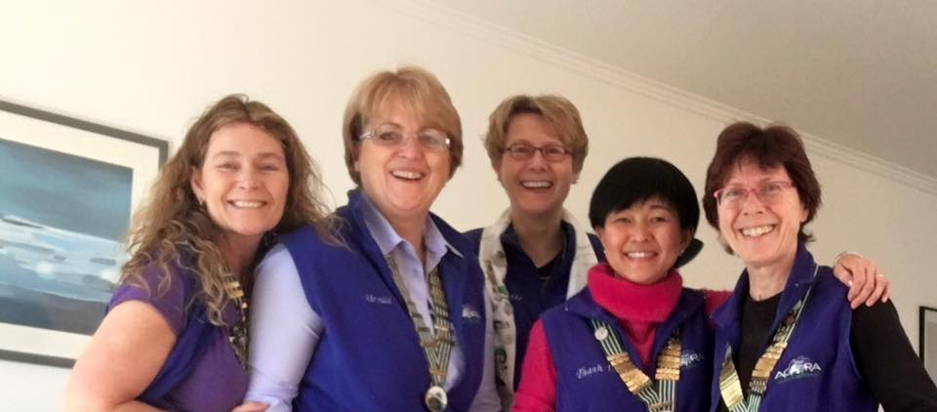
ON TO THE NEXT EVENT – OUR BOARD MEETING AT MARTINE’S HOME IN HYERES, FRANCE!

Slide 14
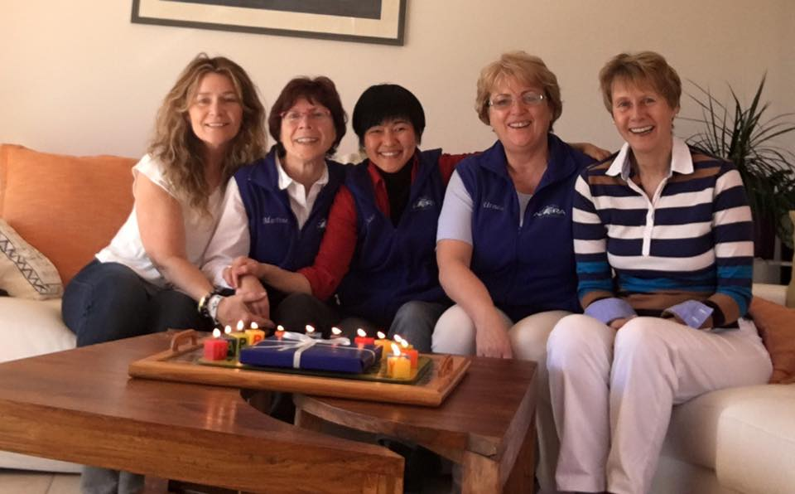
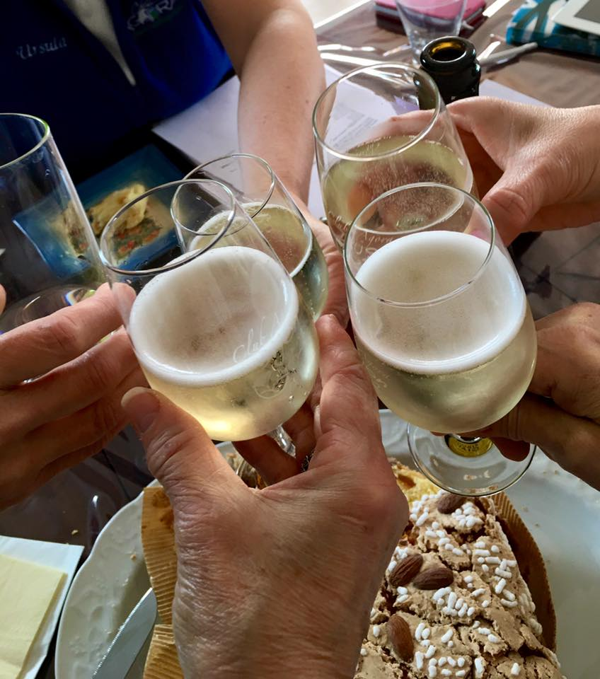
WE ARE HAPPY TO SEE ONE ANOTHER AGAIN!
CHEERS!
BROST!
SKAL!
PROST!
SALUTE!
SANTE!
NOROC!
SALUD!
PROOST!
ESPECIALLY WHEN WE CELEBRATE THANH THAO’S BIRTHDAY!

Slide 15
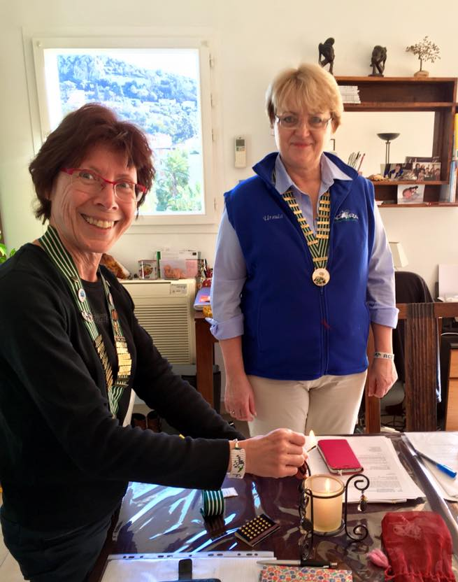
BUT IN THE DAY WE MUST WORK …
WITH MUCH TO DO FOR OUR LOVELY AGORA FRIENDS AND MEMBERS!

Slide 16
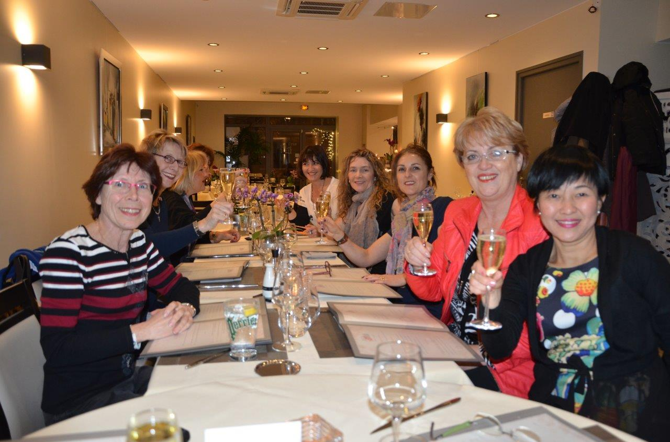
WITH EVENINGS FOR SHARING TIME WITH OUR FRIENDS OF AGORA CLUB HYERES!

Slide 17
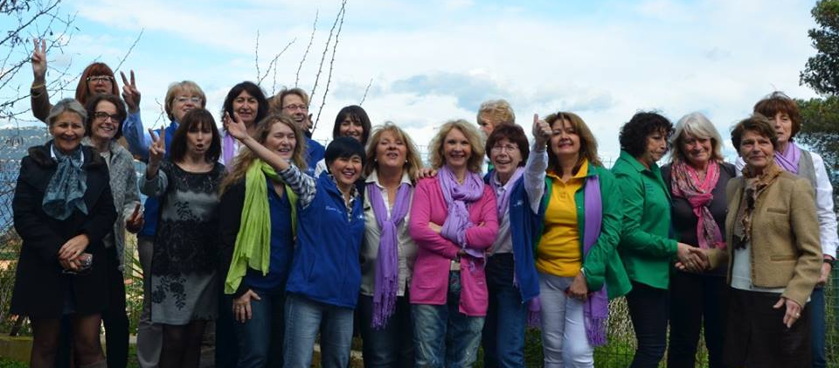
AND DURING OUR STAY – A MOST IMPORTANT MEETING OF THE 4TH REGION OF AC FRANCE!

Slide 18
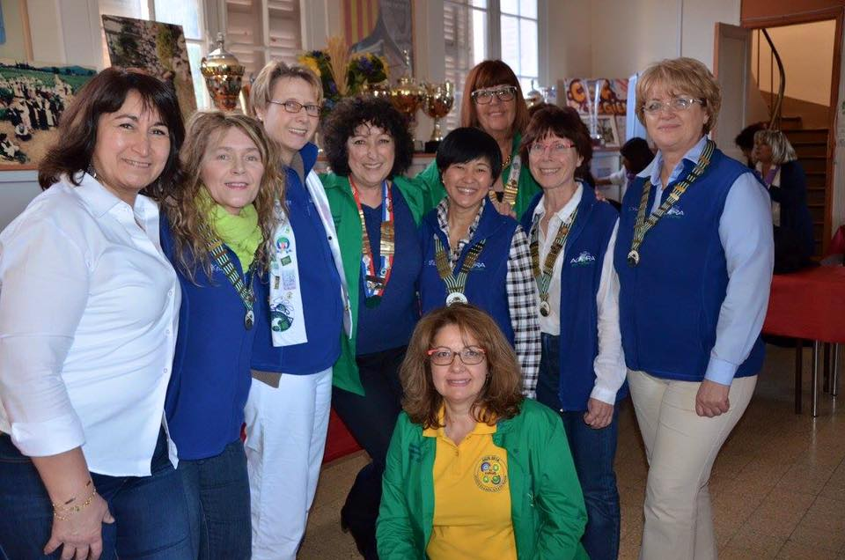
WHERE WE MET WITH SPECIAL FRIENDS AND GUESTS….

Slide 19
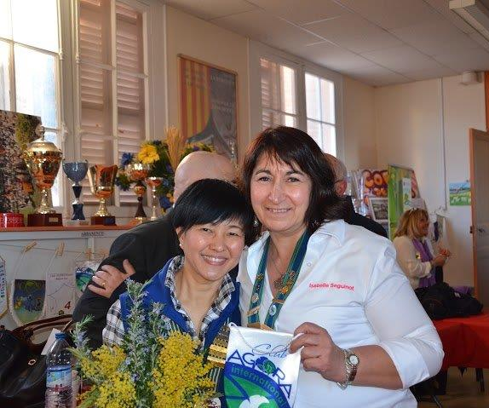
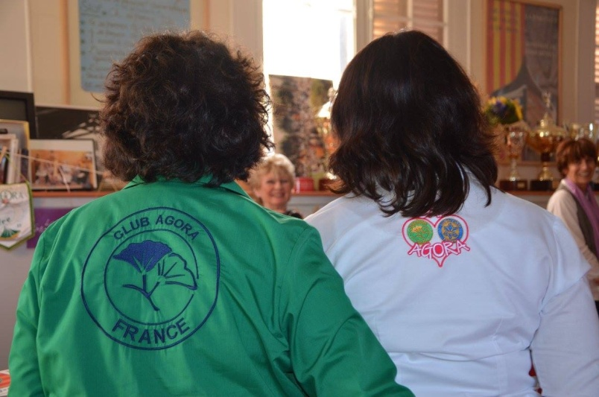
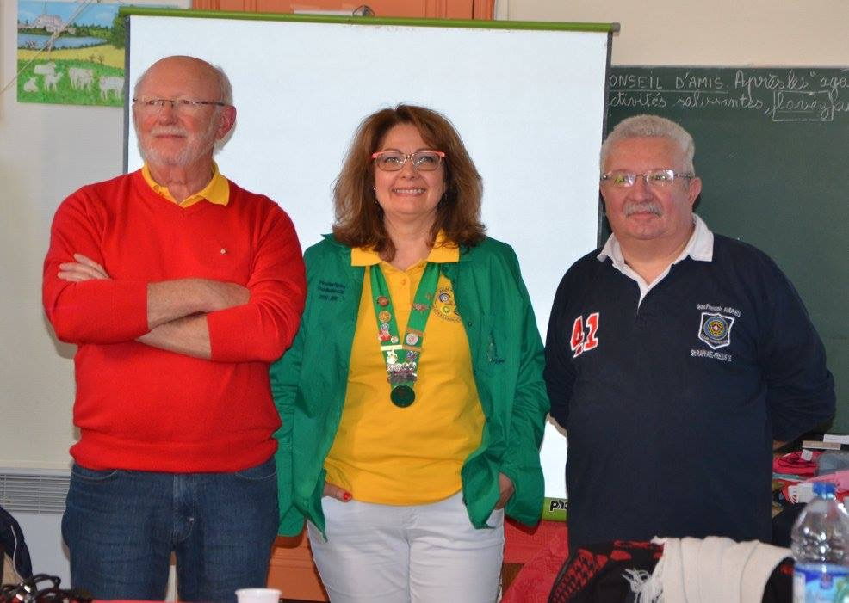
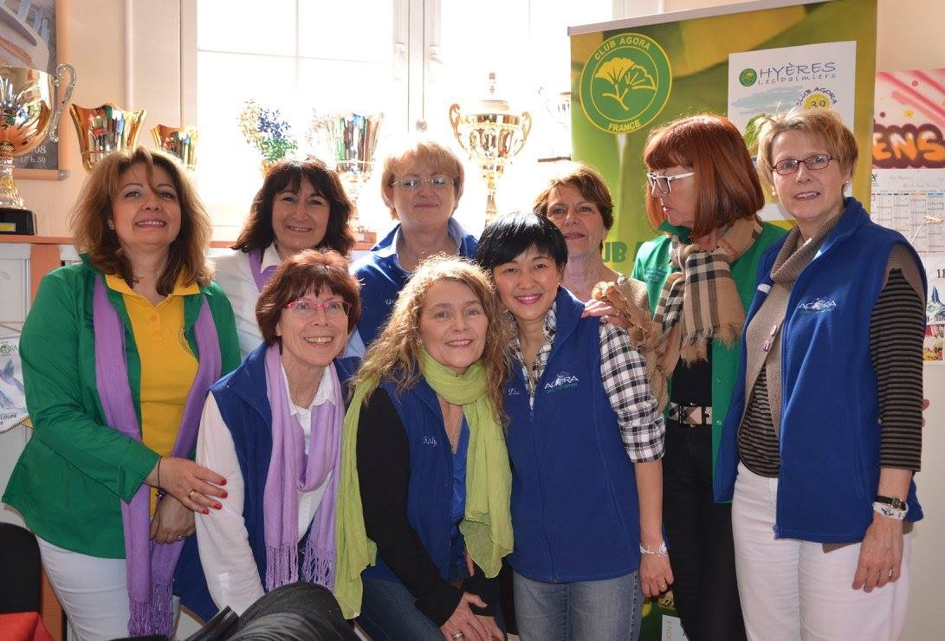
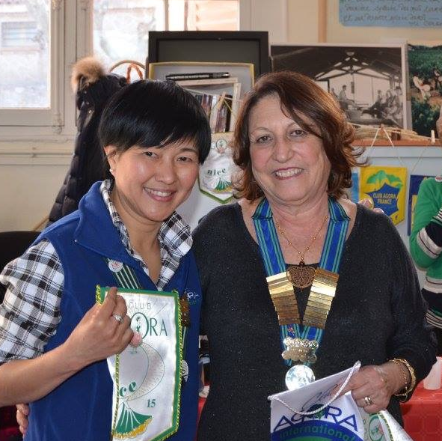
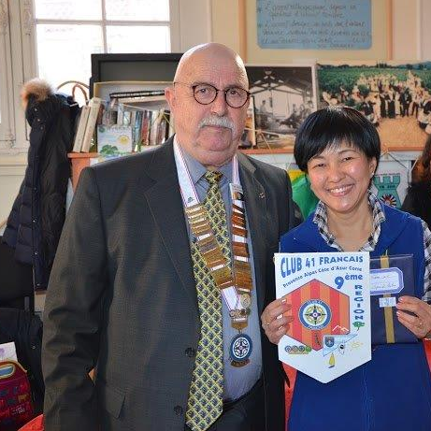
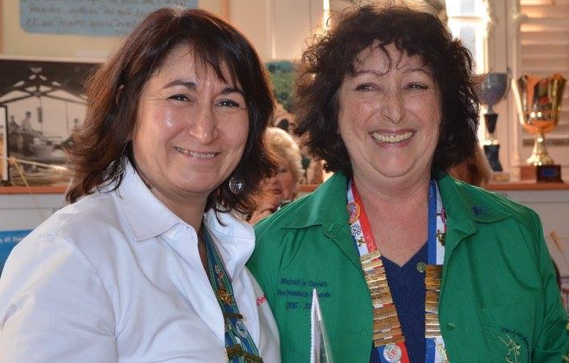

Slide 20
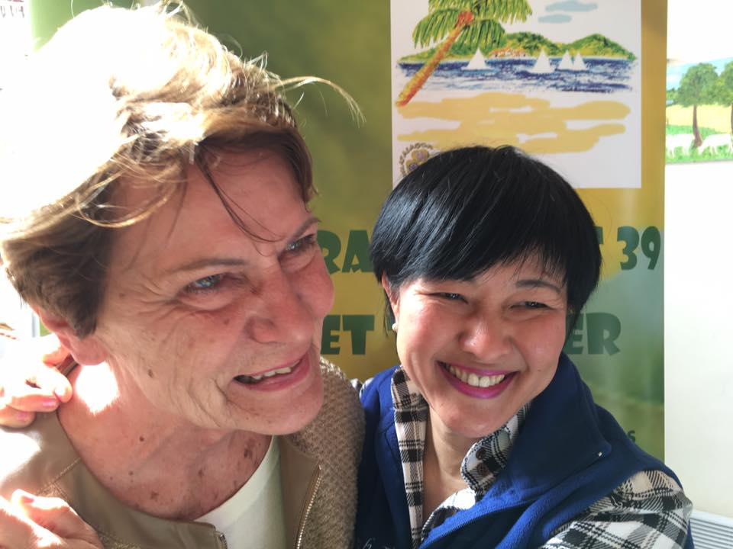
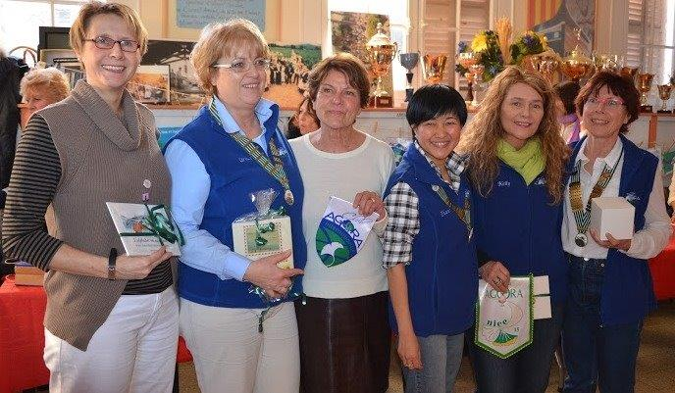
AND WERE HONORED ESPECIALLY WITH AGORA FRANCE FOUNDER - ANNICK THIERY!

Slide 21
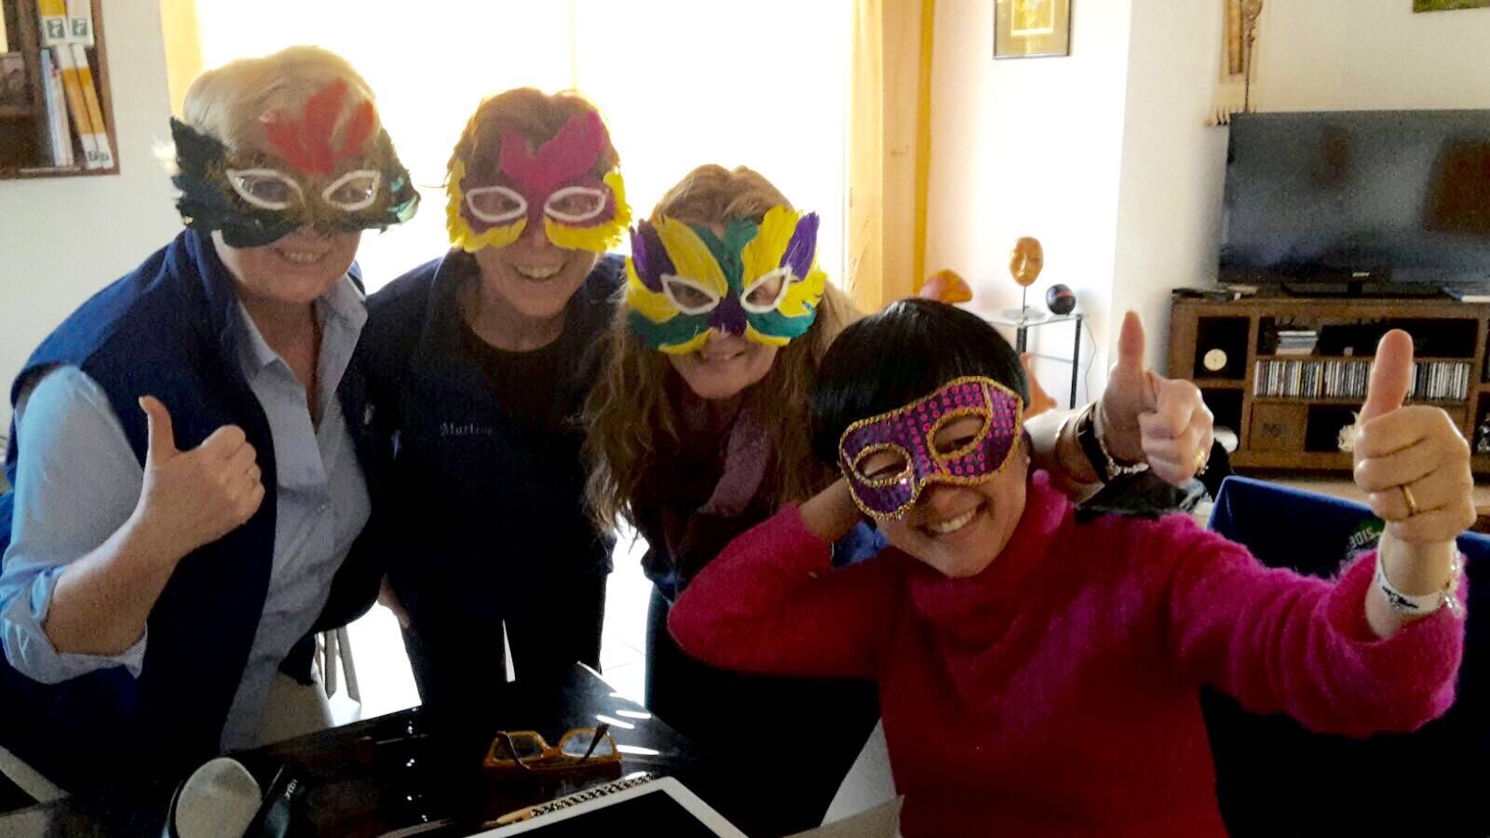
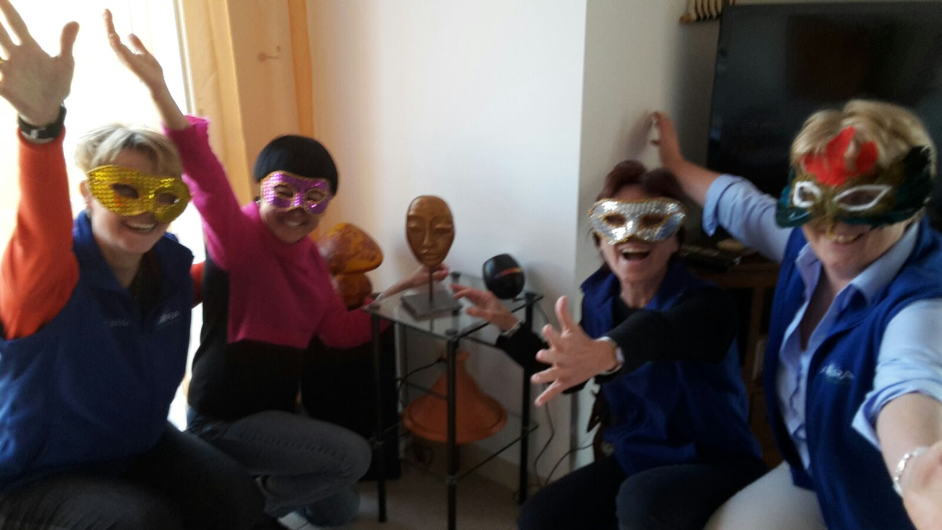
WHO ARE THESE MASKED LADIES?....
WHAT IS THEIR PLAN YOU ASK?...

Slide 22
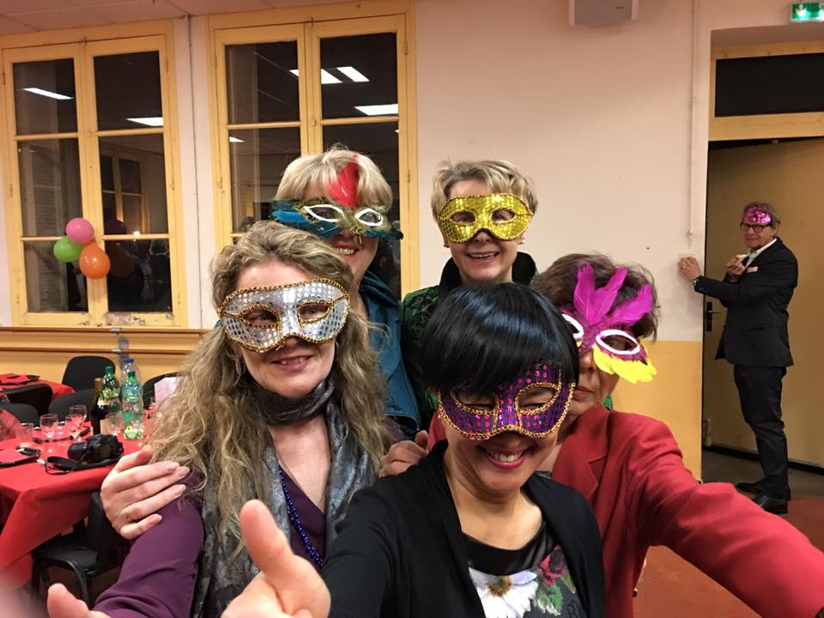
TO JOIN IN THE FUNDRAISER OF
LE FIL D’ARGENT!!
HELD BY AGORA LADIES OF HYERES FOR ALZHEIMERS!

Slide 23
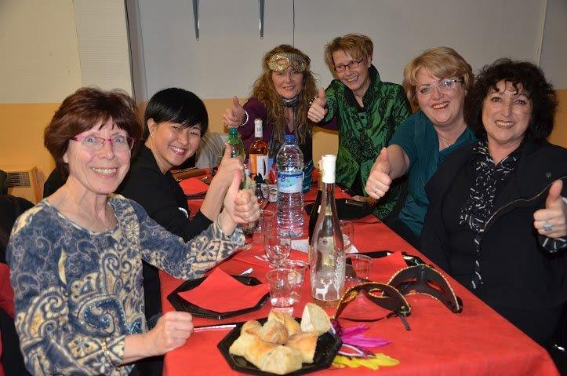
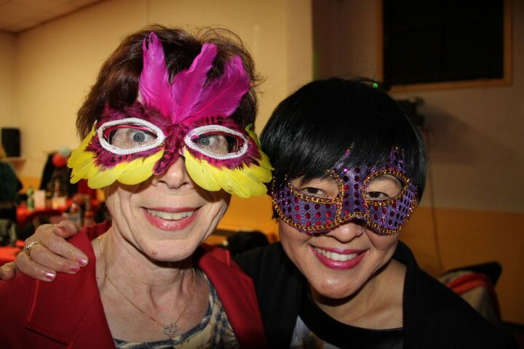
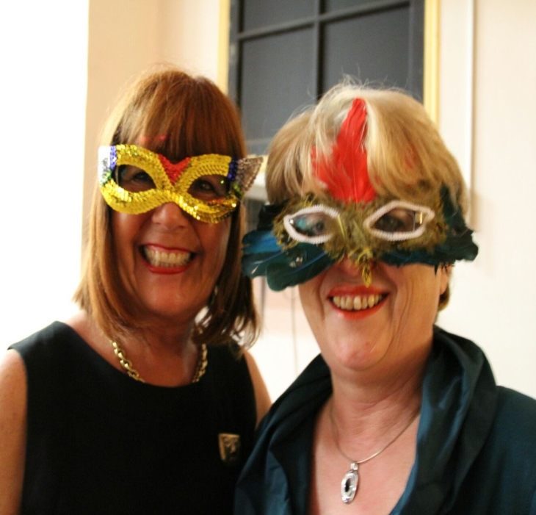
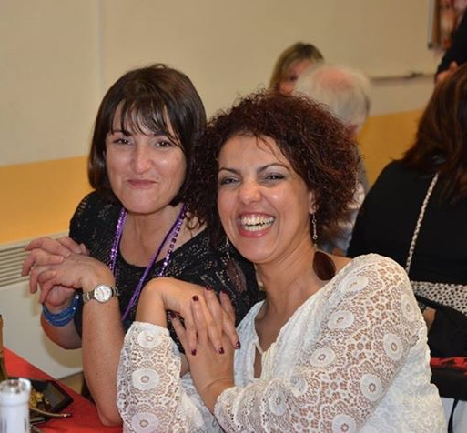
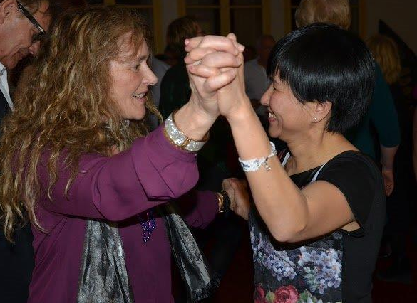


Slide 24





THUMBS UP FROM THANH THAO - A GREAT SUCCESS FROM THE BEGINNING ………..
…….TO THE VERY LAST STEP….
(A SPECIAL
THANK YOU
TO OUR
HOME HOSTS ~
ISABELLE,
MARTINE,
VALERIE &
HAVANA ♥♥♥)

Slide 25



URSULA JOINS IN 4 CLUBS 1 VISION CHRISTMASTRUCKS OF GERMANY!

Slide 26




KELLY VISITS AGORA CLUB UK & FINDS AGORA MEMBERS FROM SOUTH AFRICA & BELGIUM & FRANCE!

Slide 27








KELLY ATTENDS THE CHARTER OF LC NEW YORK CITY, USA

Slide 28

THANH THAO PAYS A VISIT TO OUR CLUB
IN FORMATION – AC ISRAEL!

Slide 29



Slide 30

THANH THAO & URSULA
AGM OF 41 INTERNATIONAL & TCI LANDSHUT, GERMANY

Slide 31






Slide 32



Slide 33

INFORMAL MEETING WITH 5 CLUBS IN ATTENDANCE ~
41 I, TCI, LCI, RTI AND ACI!

Slide 34


URSULA ATTENDS GERMANY ACT AGM

Slide 35

TIME FOR SOME…..
RANDOM ACTS OF MADNESS!

Slide 36


Slide 37


Slide 38


Slide 39




Slide 40


Slide 41




Slide 42


Slide 43


Slide 44


Slide 45


Slide 46


NOW ON A VERY SERIOUS & HAPPY NOTE ♫
MOROCCO – AND OUR VERY OWN ACI ISP -
EYES FOR THE WORLD!

Slide 47


Slide 48




Slide 49





Slide 50


Slide 51



Slide 52


THANH THAO ATTENDS THE AGM OF AGORA ITALY

Slide 53

OUR BOARD MEETING 3 HOSTED BY THE LOVELY AGORA LADIES IN SPITTAL, AUSTRIA!

Slide 54

WE CHARTERED OUR NEW COUNTRY AGORA CLUB AUSTRIA!

Slide 55






GETTING READY FOR THE PARADE & WELCOME PARTY!

Slide 56





Slide 57







Slide 58






Slide 59

THE OFFICAL CHARTER OF~AGORA CLUB SPITTAL, AUSTRIA!

Slide 60



Slide 61


THE GALA PARTY GIVEN BY AGORA & LADIES CIRCLE SPITTAL, AUSTRIA!

Slide 62








Slide 63

THANK YOU FOR HOME HOSTING US –
SONJA & MANUELA & PENKER FAMILY GERTRUDE & GOTTFRIED TAURER, CHRISTIANE & STEFAN SCHNORPFEIL!!

Slide 64

KELLY ATTENDS THE AGM OF AGORA UNITED KINGDOM

Slide 65



Slide 66


MARTINE ATTENDS AGORA FRANCE AGM

Slide 67

THANH THAO TRAVELS TO AGORA IN THE NETHERLANDS

Slide 68




Slide 69

THANH THAO ATTENDS BELGIUM’S AGM

Slide 70







Slide 71






AGORA CLUB MILANO ITALY VISITS AGORA CLUBS IN USA!

Slide 72




KELLY ATTENDS AGORA USA AGM

Slide 73

WE INTERRUPT THIS PROGRAM FOR THE LATEST IN AGORA NEWS!
THANK YOU LADIES FOR YOUR CONTRIBUTIONS TO NEWSLETTERS, OUR ACI WEBSITE AND FACEBOOK PAGE!

Slide 74



WE SHARED ON FACEBOOK OUR FRIENDSHIP, GOOD NEWS, CELEBRATIONS & LIFE’S CHALLENGES…..

Slide 75








OUR NEWSLETTERS WITH WORLD & AGORA NEWS, HISTORY, & FUTURE ACTIONS OF CLUBS, COUNTRIES, MEMBERS, & MORE!

Slide 76




CELEBRATIONS OF ACI DAY AROUND THE GLOBE!
WE ALL STAY CONNECTED TOGETHER..NO MATTER HOW FAR APART!

Slide 77


AGORA CLUBS CHARTERED THIS YEAR!
AGORA CLUB GERMANY - CHARTER OF AC HANNOVER

Slide 78



AGORA CLUB GERMANY – CHARTER OF AC GERMERING-MUNICH

Slide 79



AGORA CLUB MOROCCO - CHARTER OF AC 2 CASABLANCA

Slide 80


AGORA CLUB GERMANY – CHARTER OF AC BIELEFELD

Slide 81


AGORA CLUB FRANCE - CHARTER OF LE TAMPON

Slide 82



AGORA CLUB ICELAND – CHARTER OF AC KEFLAVIK

Slide 83


AGORA CLUB NORWAY- CHARTER OF AC EGERSUND

Slide 84





AGORA CLUB MOROCCO - CHARTER OF AC 3 MARRAKECH

Slide 85




THANH THAO VISITS AC SOUTH AFRICA

Slide 86








Slide 87



THANH THAO ATTENDS LCI AGM CAPE TOWN

Slide 88





Slide 89





Slide 90

AGORA ISP EYES FOR THE WORLD IN BOTSWANA

Slide 91





Slide 92




Slide 93

FROM THIS VERY CONTENT BOARD – WE WILL RISE UP AND DO IT AGAIN.. FOR YOU….. FOR YOU

Slide 94









Slide 95







Slide 96







Slide 97

THANK YOU FOR A WONDERFUL YEAR!
ENJOY THE AGM & MILANO!
LOTS OF LOVE
BRIGITTE, MARTINE, URSULA, THANH THAO & KELLY

